Slide 1

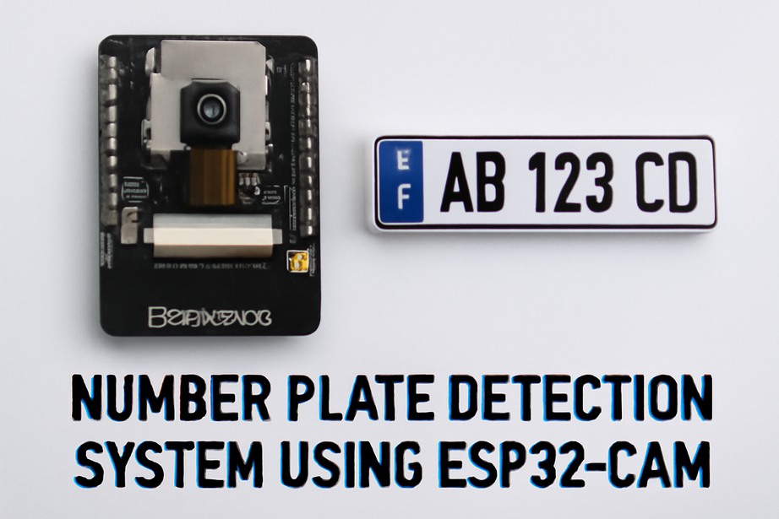
Department of Instrumentation and Automation Technology
Faculty of Technology, University of Colombo
IA 1209-Design Project
(Batch 2021/22)
Number Plate Detection System using ESP32-CAM
Group no 24
Group Numbers:
M.RAHULAN 2022T01342
B.NILUKSHAN 2022T01329
MS SAFNI 2022T01351
MJM ARSATH 2022T01266

Slide 2





Project Overview
Develop a real-time number plate detection system using an ESP32-CAM for image capture and a laptop server for processing, recognition and data store.
ESP32-CAM
Laptop Server
OLED Display
Image capture and display control.
OpenCV + EasyOCR for recognition.
Displays recognized numbers.
Push Button
Wi-Fi
triggers capture.
Enables device communication.

Slide 3





System work Flow
Capture Image
Press reset to trigger ESP32-CAM image capture.
Send to Server
ESP32-CAM sends image to laptop via HTTP POST.
Process & Recognize
Laptop uses OpenCV and EasyOCR for recognition.
Save Data
Detected number saved to file (e.g., numbers.txt).
Return & Display
Server sends number back to ESP32-CAM for OLED display.

Slide 4
Hardware and Software Components
Hardware
Software
ESP32-CAM Module: Integrated camera for image capture, Wi-Fi for data transfer.
ESP32-CAM Code: Utilizes WiFi.h, HTTPClient.h, Adafruit_SSD1306.h, and esp_camera.h for image capture, server communication, and OLED display.
OLED Display (SSD1306): Compact screen for displaying detected numbers.
Laptop Server Code (Flask): Employs Flask for web requests, OpenCV for image handling, and EasyOCR for number plate OCR.
Push Button: Triggers image capture and system reset.
Laptop: Acts as a server running Python with Flask, OpenCV, and EasyOCR.

Slide 5
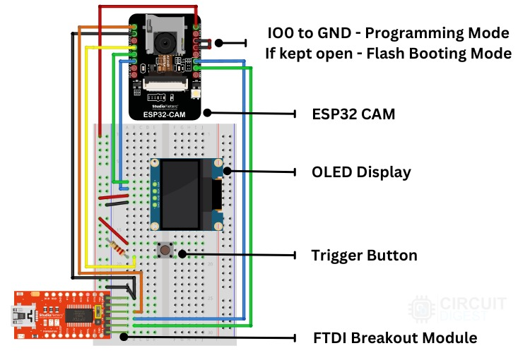
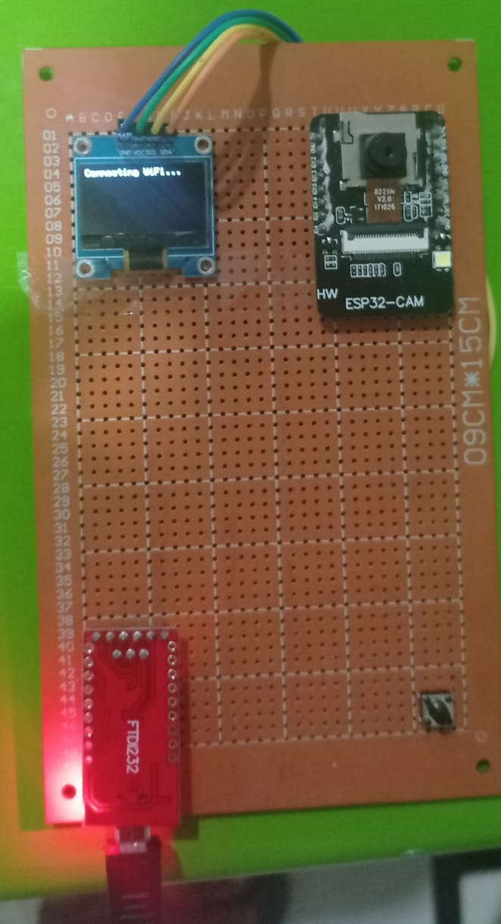
System Design Diagram
FTDI Breakout Module: Used to interface the ESP32-CAM with a computer for programming or communication
Trigger Button: Used to trigger certain actions, such as taking a photo or initiating a process.
.
.

Slide 7
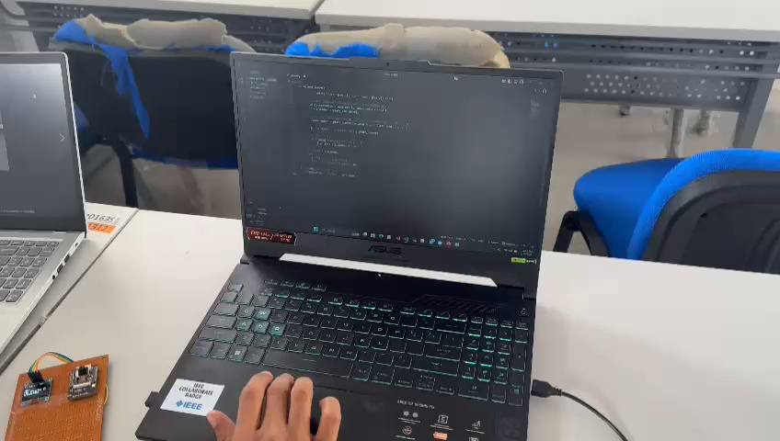
Working video

Slide 8
Esp32 cam code:
ESP32-CAM Configuration
#include <WiFi.h>
#include <HTTPClient.h>
#include <Adafruit_GFX.h>
#include <Adafruit_SSD1306.h>
#include "esp_camera.h“
// Replace with your network credentials
// OLED settings // Push button pin // Camera Pins for AI Thinker ESP32-CAM //main function (void startCamera())
The ESP32-CAM is configured with Wi-Fi credentials and camera settings for optimal image capture. Key aspects include pin assignments and image quality parameters to ensure clear number plate readings.
Key Functions
setupCamera(): Initializes camera hardware and pin configurations.
captureImage(): Acquires image frame buffer and handles HTTP POST requests to send the image data to the server.
Ftdi module use to program the esp32 cam
We use c++ programming language in the aurdino ide to program the esp32 cam
5 Libaries in code structrue

Slide 9
Server Code (Flask) and EasyOCR Integration
Flask Server
from flask import Flask, request, jsonify
import easyocrimport cv2
import numpy as np
app = Flask(_name_)reader = easyocr.Reader(['en'])
@app.route('/upload', methods=['POST'])def upload_image():
img_bytes = request.data
nparr = np.frombuffer(img_bytes, np.uint8) img = cv2.imdecode(nparr, cv2.IMREAD_COLOR)
# Run OCR results = reader.readtext(img)
if results: number_plate = results[0][1] print("Detected:", number_plate)
# Save to file with open("numbers.txt", "a") as f: f.write(number_plate + "\n")
return number_plate
else: return "No Plate Detected", 400
if _name_ == '_main_':
app.run(host='0.0.0.0', port=5000)
The Flask server acts as the central processing unit, receiving image data via HTTP POST requests from the ESP32-CAM. It leverages Python libraries to perform the core recognition tasks.
EasyOCR for Recognition
Text Detection: EasyOCR efficiently detects and extracts text from images, crucial for diverse number plate formats.
Multi-language Support: Extensible for global application, supporting various character sets.
Real-Time Feedback: Recognized numbers are swiftly returned to the ESP32-CAM for immediate display, enhancing user experience.

Slide 10



Key Applications
Real-Time Monitoring
License Plate Recognition (LPR)
IoT Integration
Vehicle tracking in parking lots, toll gates, and security systems.
Seamlessly integrates with smart cities and other IoT applications.
Automated systems for law enforcement, access control, and traffic.

Slide 11
Future Improvements and Applications
Enhancements
Applications
Accuracy: Fine-tune the OCR model for diverse plate formats.
Real-Time Monitoring: Parking lots, toll gates, security.
Machine Learning: Integrate advanced models for robust recognition.
LPR Systems: Law enforcement, access control, traffic.
Range: Upgrade camera resolution for superior image quality.
IoT Integration: Smart cities and vehicle monitoring.
Edge Computing: On-device processing to reduce server dependency.

Slide 12
System Functionality & Testing
1
2
3
Image Capture
Number Plate Recognition
OLED Display
ESP32-CAM successfully captures and sends images to the server.
Laptop server processes images and recognizes number plates.
ESP32-CAM displays the recognized number correctly on the OLED.

Slide 13
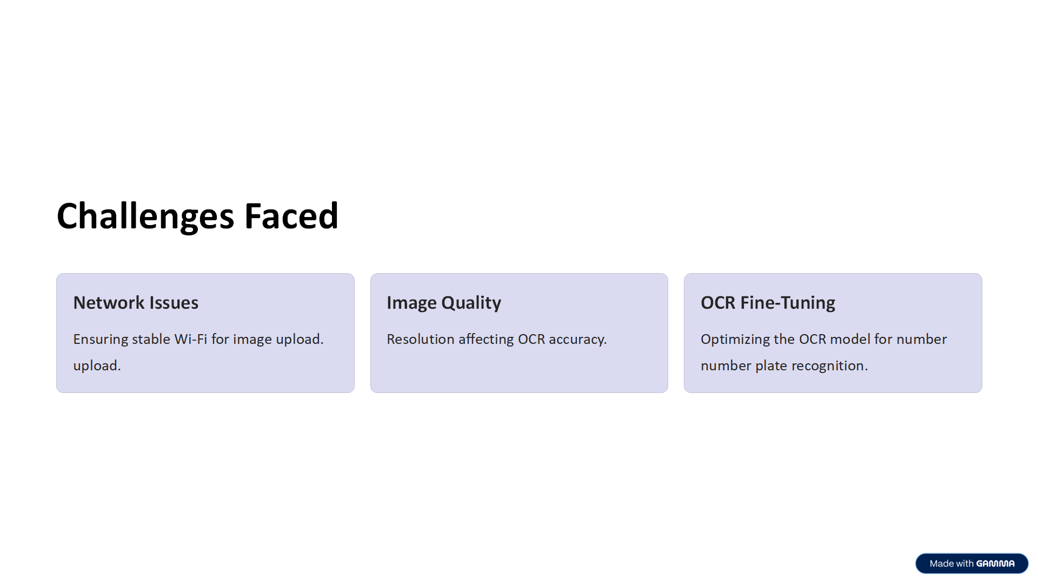

Slide 14
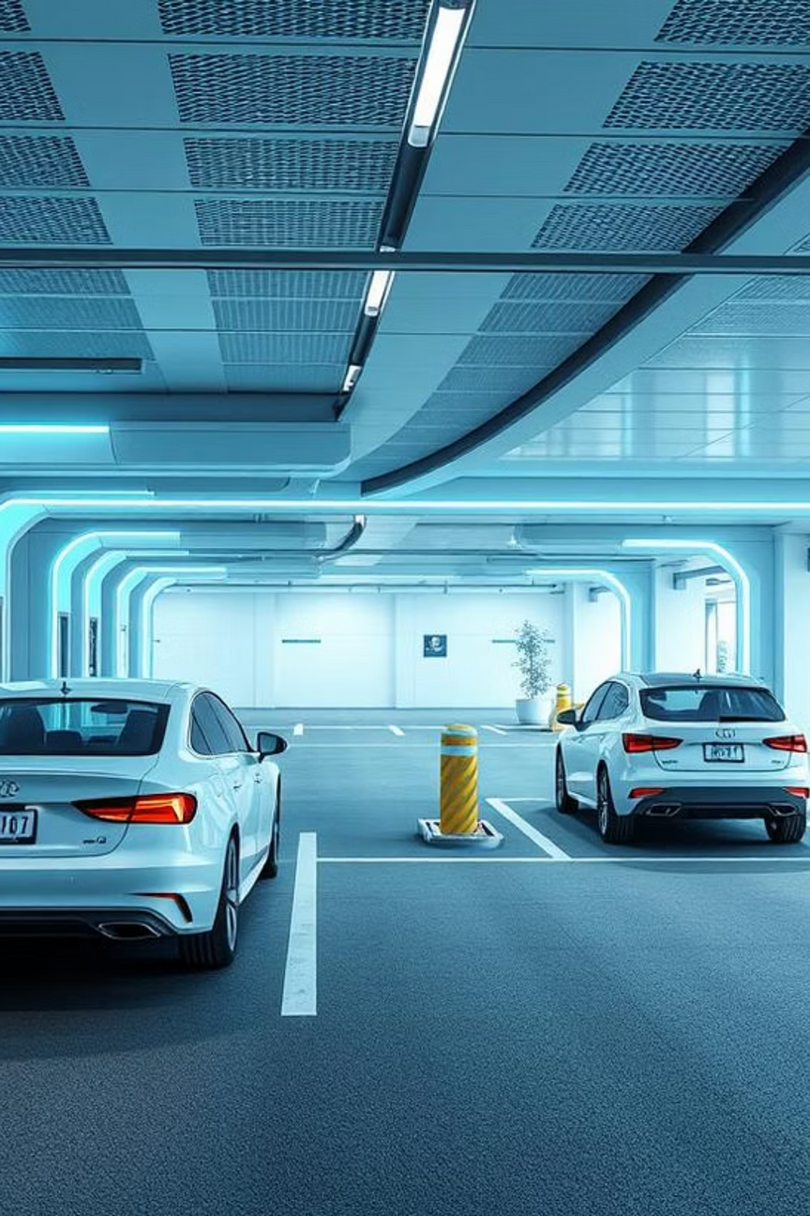
Conclusion
Developed a number plate detection system using ESP32-CAM and a Python server. It captures, processes, and displays results. Challenges included Wi-Fi stability and OCR optimization. Future work involves large-scale implementation in parking management or law enforcement.

Slide 15
Thank You!
Questions and Discussions

